Slide 1
DATA SCIENCE

Slide 2
What is Data Science ?
Data science is referred to the process of collecting, storing, segregating and analyzing data which serves as a valuable resource for organizations to carry out data-driven decision making

Slide 3
Languages used in Data Science ?
Python
R
SQL
Julia
Scala
SAS

Slide 4
Why to learn Data Science ?
To make most out of their data, companies from all domains, like Finance, Marketing, Retail, IT , Healthcare , Social Media or Bank. All are looking for Data Scientists . IBM is declaring it as trending job of 21st century.

Slide 5
Scope of Data Science ?
To make most out of their data, companies from all domains, like Finance, Marketing, Retail, IT , Healthcare , Social Media or Bank. All are looking for Data Scientists . IBM is declaring it as trending job of 21st century.

Slide 6
AI vs DS vs ML

Slide 7
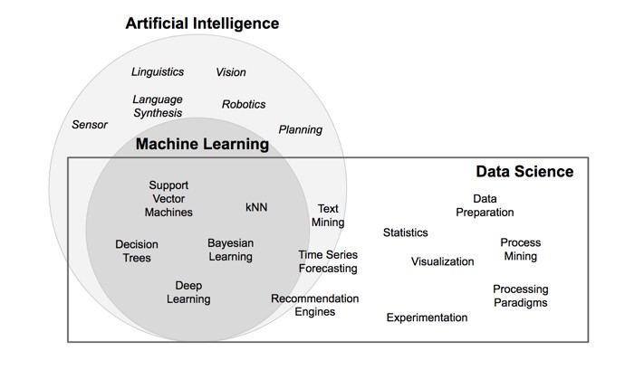
AI vs DS vs ML

Slide 8
Roles in Data Science ?
Data Scientist
Data Analyst
Data Engineers
Database Administrator
Machine Learning Engineer
Data Architect
Statistician
Business Analyst

Slide 9
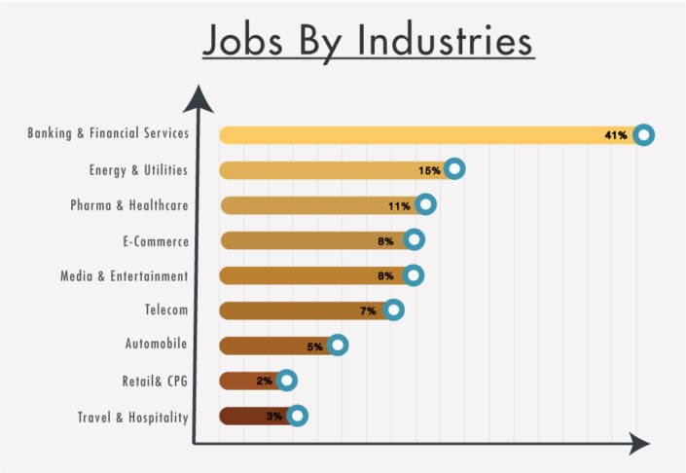
Careers
Banking & financial are the leaders with over 40% all jobs advertised
Energy and Utilities contribute 15% of total jobs

Slide 10
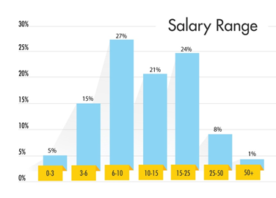
Packages
Nearly 46% of Data Scientists earn a salary between 6-15 LPA.

Slide 11
Course Outline

